Slide 1

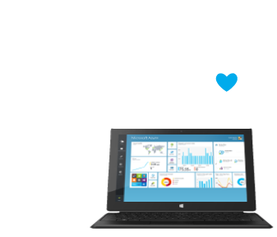
Introduction to Azure
Microsoft's application platform for the public cloud
Web Services and Cloud
Telerik Software Academy
http://academy.telerik.com

Slide 2
Table of Contents
What is Microsoft Azure?
Compute Services
Web + Mobile Services
Data + Storage Services
Internet of Things, Big Data and Machine Learning
Networking, Mobile, Back-up
Messaging and Integration
Compute Assistance
Performance
Big Data and Big Compute
Media

Slide 3
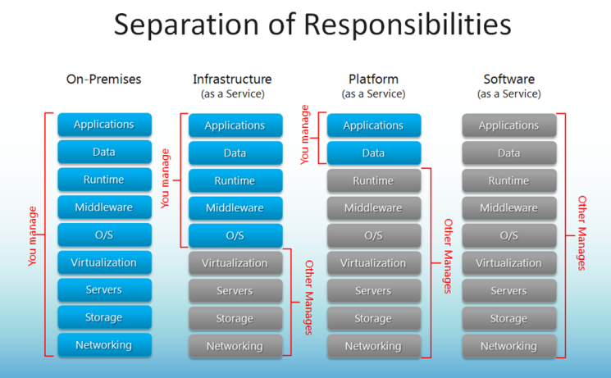
Cloud Computing
A virtualized computing platform that provides infinite resources for running your applications
Leverages economies of scale to save you money (pay for what you use)

Slide 4
What is Microsoft Azure?
Microsoft Azure is a cloud computing platform and infrastructure created by Microsoft
It is provided in Microsoft datacenters located around the world (US, Europe, Asia, Australia)
https://youtube.com/watch?v=0uRR72b_qvc
It provides a range of services that developers and operations people can use, including:
Running and connecting applications
Storing, managing and analyzing data
Networking, media (CDN), IoT, security
Many more

Slide 5
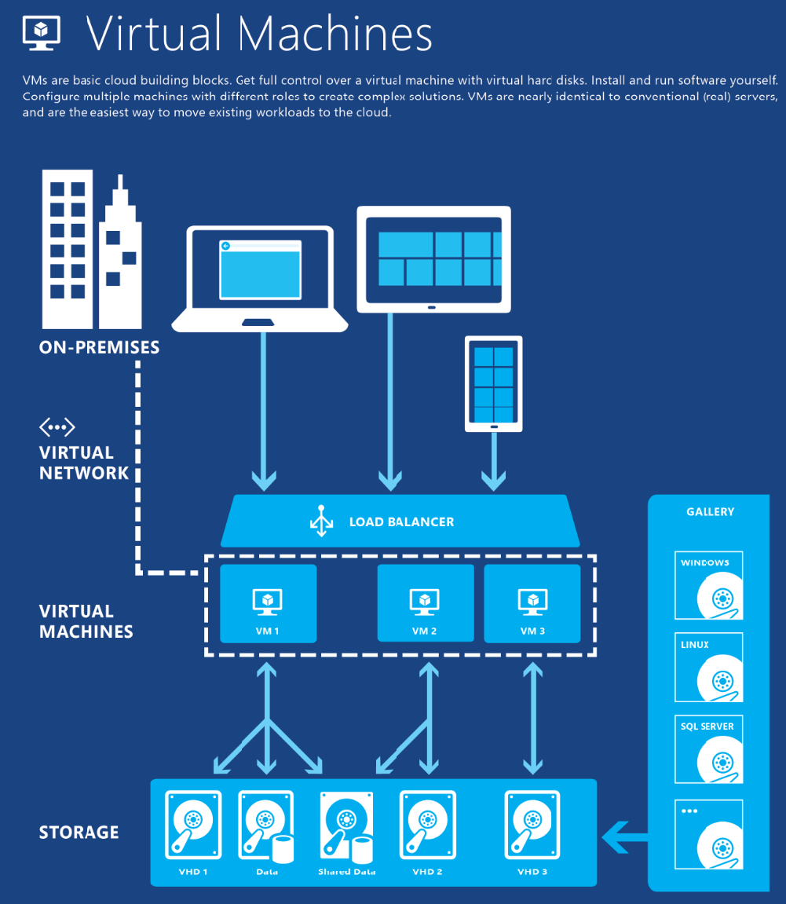

Slide 6
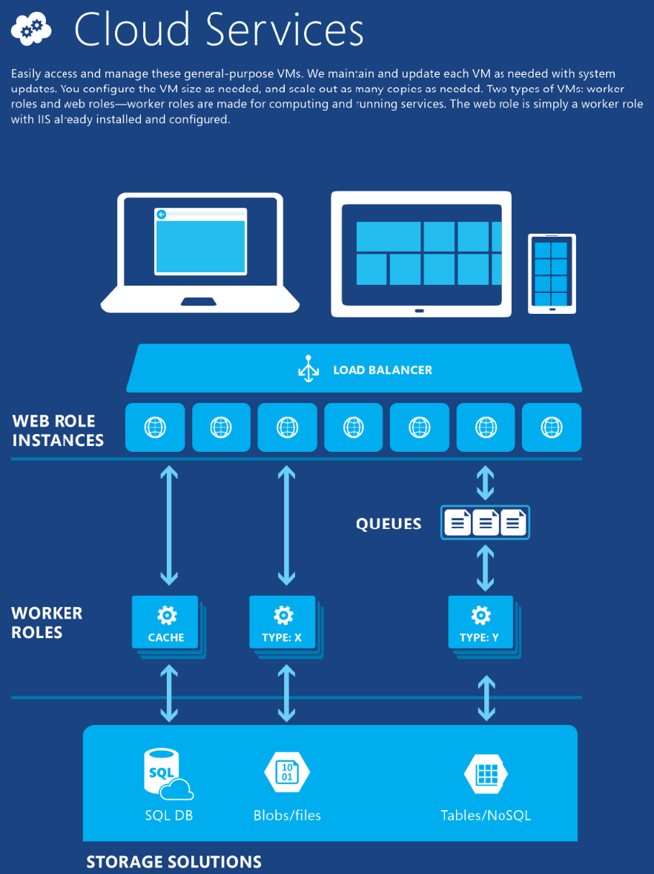

Slide 7
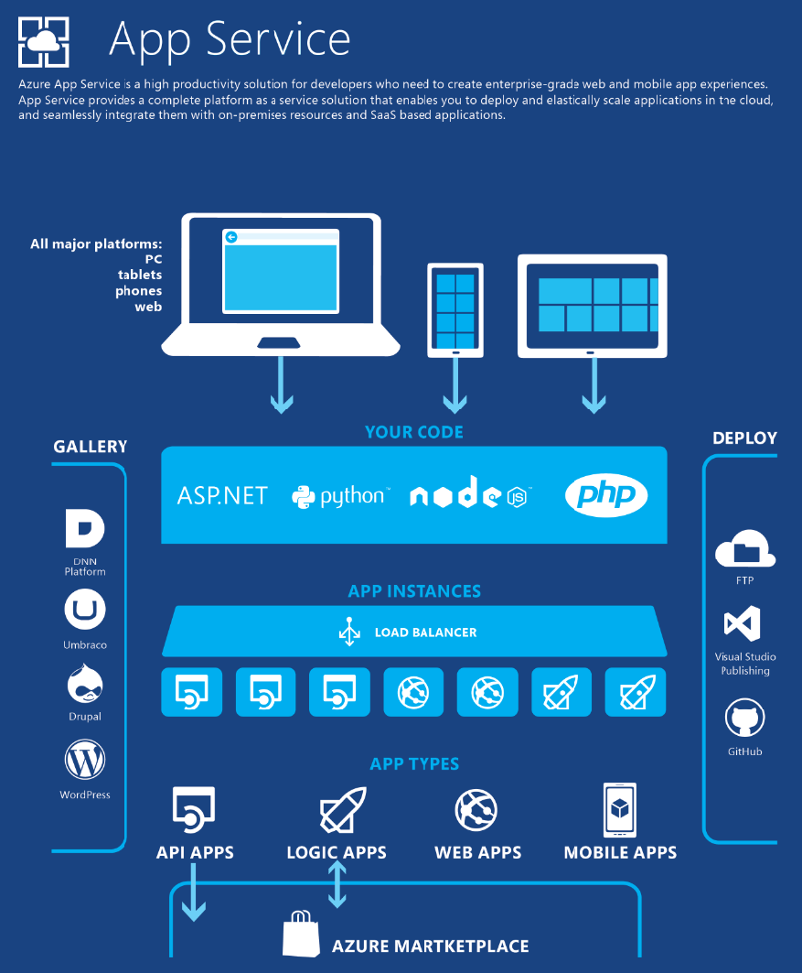

Slide 8
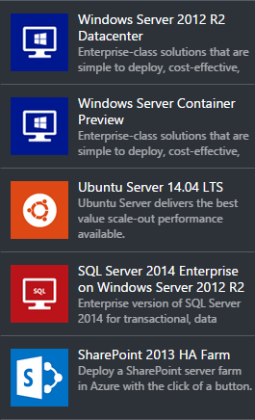
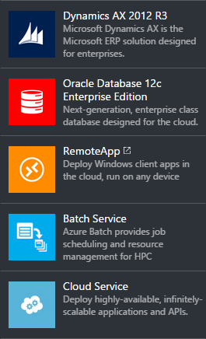
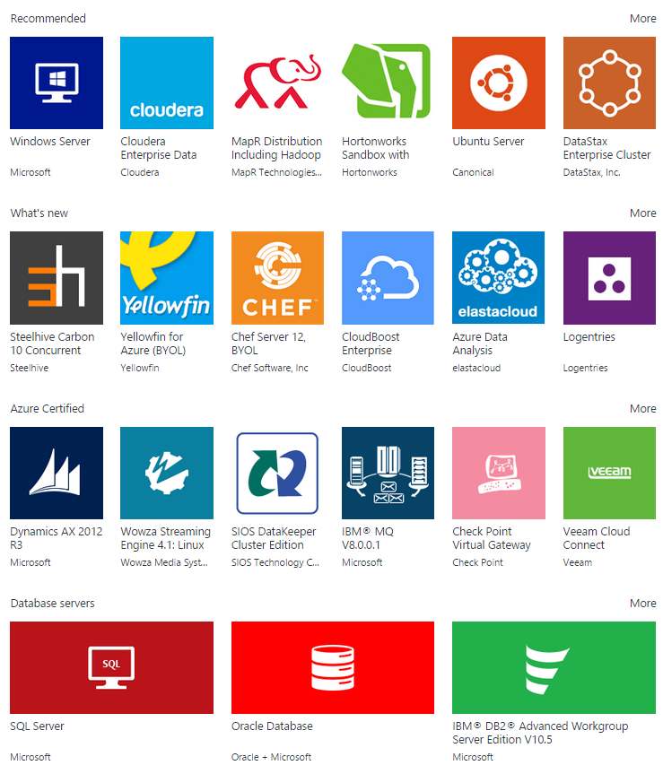
Computing
Computing cloud solutions provided by Azure:
https://youtube.com/watch?v=jmEZqBFTNk4

Slide 9
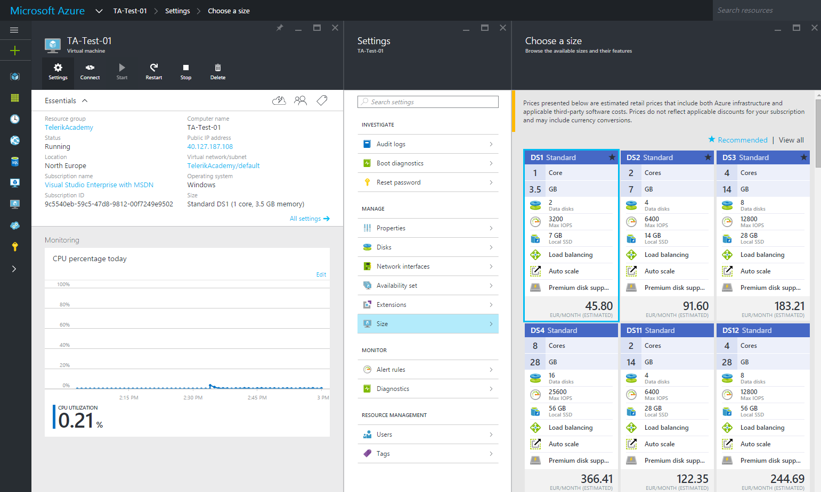
Demo: Windows Server VM
Create Windows Server VM
Connect using Remote Desktop
Manage the Virtual Machine

Slide 10
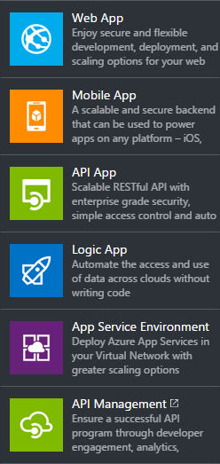
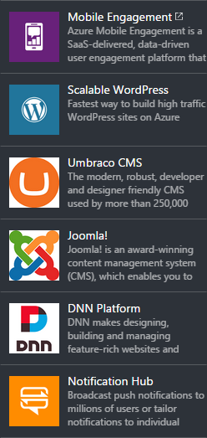
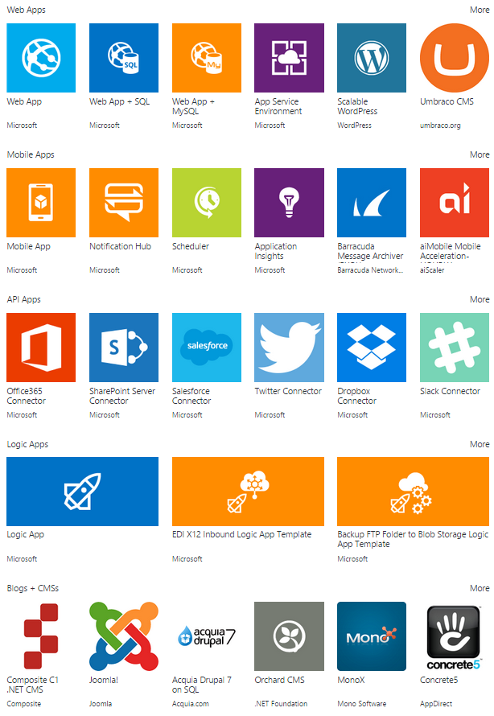
Web + Mobile
Web and Mobile Services by Microsoft Azure

Slide 11
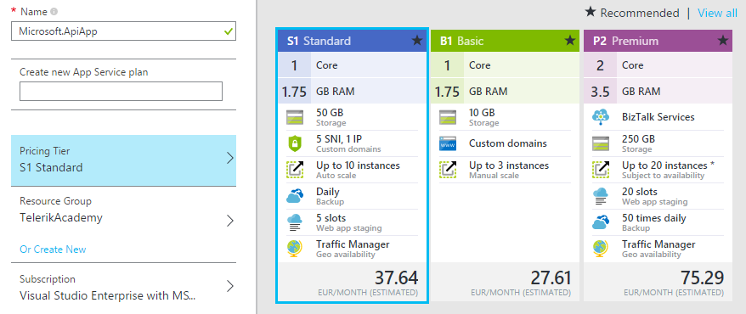
Demo: Create API App
asd

Slide 12
Demo: Deploy ASP.NET Web API in the Cloud
asd

Slide 13
Storage
https://youtube.com/watch?v=FWGtgpzjAPM

Slide 14
More Videos
Machine Learning
https://youtube.com/watch?v=SJtNJepz-pM
Microsoft Advanced Threat Analytics
https://youtube.com/watch?v=-MGg_07MkgY
Internet of Thinks
https://youtube.com/watch?v=L8xjSjxaaVA
https://youtube.com/watch?v=Z7GzCjT77Po

Slide 15
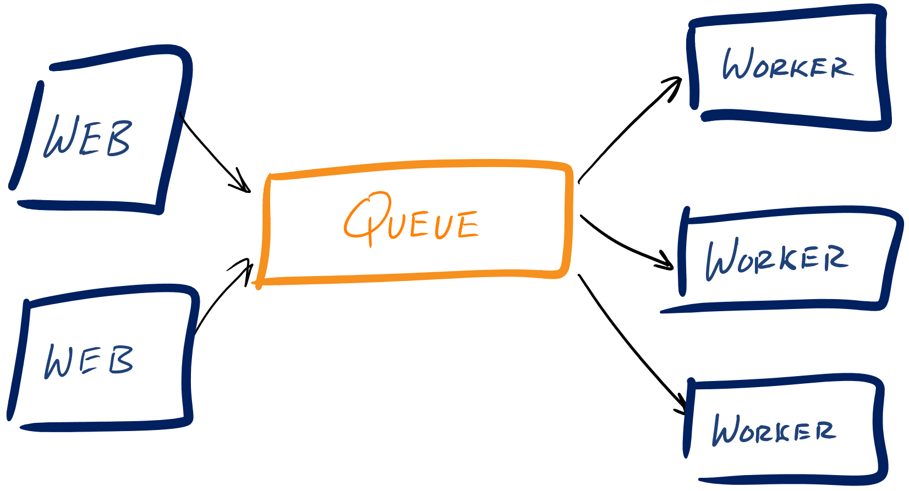
Popular Cloud Architectures
A Web Role is an Azure VM that is pre-configured as a web server (running ASP.NET MVC for example)
Worker Roles run alongside your Web Roles and are responsible for performing computing functions to support your application

Slide 16
Questions?
Introduction to Azure

Slide 17
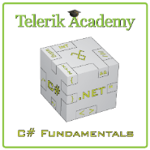



Free Trainings @ Telerik Academy
C# Programming @ Telerik Academy
csharpfundamentals.telerik.com
Telerik Software Academy
academy.telerik.com
Telerik Academy @ Facebook
facebook.com/TelerikAcademy
Telerik Software Academy Forums
forums.academy.telerik.com

